Slide 1
Cyber Physical System Sec/Design CS- 557
Paper Presentation
Presented by : Lavanya Juvvala Guidance by: Prof. Rujia Wang

Slide 2
Paper Title and Authors
Watching You Watch : The Tracking Ecosystem Of Over-the-top TV Streaming Devices.
Authors:
Hooman Mohajeri Moghaddam, Gunes Acar, Ben Burgess,
Arunesh Mathur, Danny Yuxing Huang, Nick Feamster∗,
Edward W. Felten, Prateek Mittal, Arvind Narayanan
Princeton University and University of Chicago∗

Slide 3
01
03
05
INTRODUCTION
METHODOLOGY
DEFENSES
02
BACKGROUND
04
06
FINDINGS
CONCLUSION

Slide 4

Introduction

Slide 5
OVERVIEW
Privacy practices of OTT(Over-the-top) streaming devices like Roku TV and Amazon Fire TV
Developed a system called Smart Crawler, that can automatically download OTT apps and intercept the network traffic
Discovered how unique identifiers like Device IDs, serial numbers, Wi-Fi MAC address and SSID are collected and transmitted, sometimes even over unencrypted connections
Proved why countermeasures such as limiting ad tracking and adblocking are practically ineffective

Slide 6
Key Challenges Faced
Automated Interaction: There is a lack of fine-grained feedback such as what text is shown on the TV screen , is it a video clip or video ad that is being played on TV, makes it difficult to execute commands.
Mitigation: To overcome this lack of feedback, a system was developed which uses audio and pixel content to infer the state of the video playback on TV.
Intercepting Traffic: Unlike web browsers and mobile devices where HTTPS traffic can be intercepted by installing root certificates, OTT streaming devices are largely closed and proprietary. This makes it harder to intercept the encrypted traffic.
Mitigation: Modifying mitmproxy to intercept and decrypt HTTPS traffic via best effort.
Deploying their own TLS certificate to the device and use of external of external toolkits help to
bypass certificate pinning.

Slide 7
Significant Contributions
First large-scale study of privacy practices in OTT streaming channels using an automated crawler
First system that can automate the interaction of OTT channels and interception of OTT network activities
Discovered collection of persistent identifiers for tracking over unencrypted connections.
Discovered vulnerabilities in remote control APIs of OTT device which allows extraction of Roku user’s location, retrieval of installed channels, install new channels and access device identifiers.

Slide 8
Background

Slide 9
Background
Web Tracking: Techniques and Measurement
Identification of third-party JavaScript on Alexa top 10,000 websites and new ways to compromise websites like registering stale domains from where victim websites load scripts.
Discovery that websites which leak user data contact an average of nine different third parties.
FPDetective was built to measure the prevalence of various fingerprinting techniques on the web over Alexa top 1 million websites.
OpenWPM- an instrumented web crawler was developed based on Selenium to measure the various kinds of browser fingerprinting on Alexa top 1 million pages.
Discovered that several third parties in top 100K Alexa website use sensor APIs –such as motion, orientation proximity and light-available in mobile browsers for tracking.

Slide 10
Background
Mobile Tracking: Techniques and Measurement
50% of smart phone traffic can be attributed to users’ real names.
Popular children’s apps violated COPPA.
Explored ways to track users on mobile platforms by fingerprinting smartphone, configs, sensors, battery readings.
Ran a study to measure PII exposure on 100 popular iOS, Android, Windows phone apps.
Privacy and Security of Smart Devices
Studied the security of 499 SmartThings in Samsung SmartThings’ Platform and found security flaws.
Discovered that out of four medical devices, one device occasionally sends sensitive health data in clear text.

Slide 11
Methodology

Slide 12
Methodology : Platforms and Channel Stores
Roku Tv
Amazon Fire TV
Users can download and install channels from Roku Channel Store
As a privacy option, Roku allows users to “Limit Ad Tracking” to disable identifiers used for targeted advertising
Roku streaming devices run a proprietary operating system developed by Roku, Inc. Roku Channels are packaged, signed and encrypted to ensure that only Roku devices can decrypt the channels.
Users can download and install channels from Amazon Fire TV Channel Store
Amazon allows users to “Disable Interest based ads” and limit behavioural profiling and targeting
Amazon Fire TV devices run a custom version of the Android OS. Amazon channels are packaged in the Android Application Package (APK) format so developers can interact with the Fire TV devices using the Android Debug Bridge (adb) tool.

Slide 13
Methodology : Compiling Channel Lists
Roku Tv
Amazon Fire TV
Each Channel belongs to only one category
A new list was created by sorting the list of 8,660 channels by rank and retaining the top 1,000 channels (Roku-Top1K).
A list of 100 channels (Roku-Categories-Top100)was created by selecting the top 10 channels by rank from these categories: “Movies & TV”, “Kids & Family”, “Sports” , “Fitness”, “Religious”, “Food”, “Shopping”, “Educational”, “Special “Interest”, and “News & Weather”
Some channels belong to multiple categories
Retained the top 1,000 channels by rank (FireTV-Top1K) for crawling.
A list of 100 channels (FireTV-CategoriesTop100) was created by selecting the top 10 channels by rank from these categories: “News & Weather”, “Movies & TV”, “Sports”, “Lifestyle”, “Health & Fitness”, “Food & Drink”, “Kids”, “Shopping”, and “Education”

Slide 14
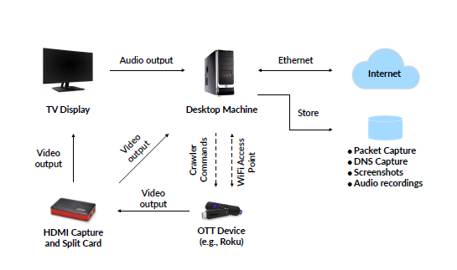
Smart Crawler Infrastructure
The smart crawler consists of four physical devices: a desktop machine, a TV display, an HDMI split and capture card, and the OTT device.
The desktop machine executes the crawler code, orchestrates the crawl and stores the resulting data. It acts as a Wi-Fi access point (AP).
The OTT device connects to this AP, which captures the network traffic. The OTT device outputs its video to both a TV display and a desktop machine.
The TV display visually shows the crawler’s behavior and the screenshot captures on the desktop machine are used to validate the findings.
Finally, the TV display’s audio output connects to the desktop machine’s audio input that captures into files.

Slide 15
Triggering Video Playback
While the crawler can interact with channels using the OTT device’s remote control APIs, triggering video playback in an automated fashion is challenging because channels’ user interfaces vary widely.
But the probability of triggering video playback in channels can be maximized. First analyze how a human would interact with a channel to play a video. For each channel, the shortest sequence of keystrokes were recorded which led to video playback (e.g., the “Down” button followed by the “OK” button).
The three sequences that triggered video playback on the most channels were: [OK, OK, OK], [Down, OK, OK] and [OK, OK, Down, OK, Down, OK].
The crawler employs these three sequences and checks for audio output signal, if no audio signal is detected it will assume that the key sequence didn’t work. Thus it restarts the channel and proceeds to play remaining key sequences.

Slide 16
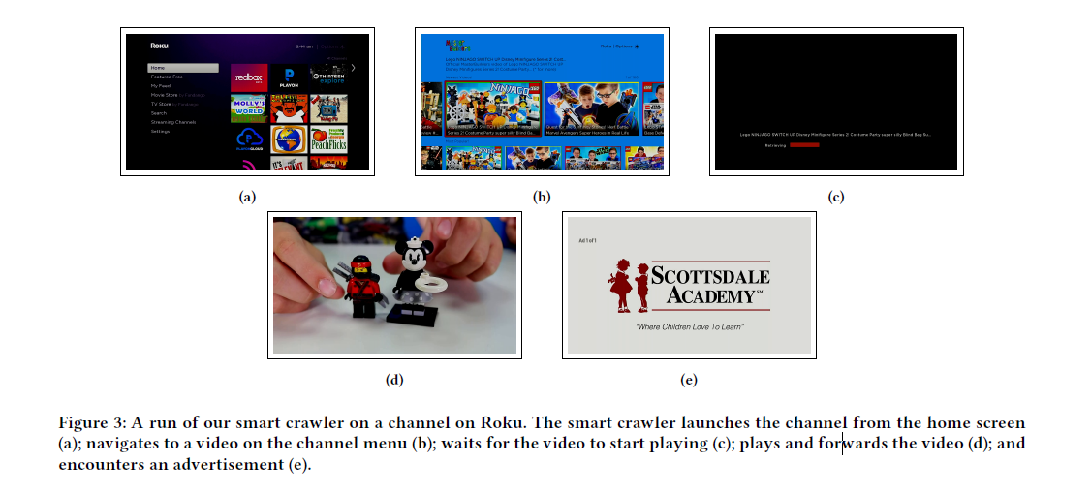

Slide 17


Slide 18
List of Crawls
Smart Crawls
Crawled top 1000 channels on both Roku and Amazon Fire tv.
In first, encrypted traffic was intercepted this was called Roku-Top1K-MITM and FireTV-Top1K-MITM
Next, the same channels were crawled without intercepting any encrypted traffic. This was called Roku-Top1KNoMITM and FireTV-Top1K-NoMITM.
Examining the efficacy of the privacy settings provided by Roku and the Amazon Fire TV. They crawled the top 100 channels — Roku- CategoriesTop100-MITM and FireTV-CategoriesTop100-MITM
Repeated the same crawls, enabling the “Limit AdTracking” (Roku) and the “Disable Interest-based Ads” (Amazon Fire TV) settings.
These are called Roku-Categories-Top100-LimitAdTracking and FireTV-CategoriesTop100-DisableInterestAds

Slide 19
List of Crawls
Manual Crawls
The smart crawler is optimized to play videos on many kinds of channels, it fails to navigate channels that require human input .
To overcome this limitation, they manually interacted with the top 30
channels by rank.
This included signing up for accounts and paying for premium and paid services using a credit card where necessary. They are called Roku-Top30-Manual-MITM and FireTV-Top30-Manual-MITM
The manual crawls collected the same network-level data as the smart crawls.

Slide 20
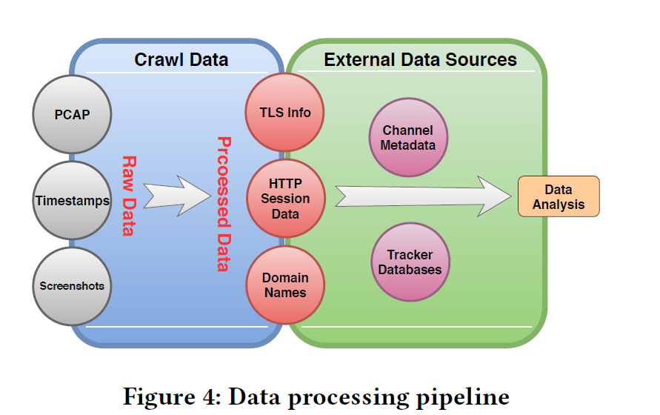
PROCESSING CRAWL DATA
Data Files
PCAP Dumps
SSL Key Log Files
Events and Timestamps
TLS Artifacts
Screenshots
Audio Recordings
Data Processing
After gathering the raw data in each crawl , processing step is performed to extract relevant information.
Intercept TLS connections as successful if there is at least one TLS record containing payload sent from OTT device and the rest as interception failures.
DNS queries are used to determine host name corresponding to a destination IP addresses.
Extracted headers and payload from HTTP/1.1 and HTTP /2 and mapped them for ease of processing.
Channel metadata is used to retrieve channel ID, category, and rank to label the network traffic
Five popular ad-blocking/tracking protection lists are used to check the blocked status of HTTP requests and TCP connections:
EasyList , EasyPrivacy , Disconnect , Ghostery and Pi-hole

Slide 21
Findings

Slide 22
FINDINGS: OVERVIEW
First, the number of “completed” channels are counted in a crawl. “Completed” channels are defined as those that were successfully installed, interacted with, and then uninstalled by our crawler.
Second, the number of channels for which smart crawler was able to reach video playback by using the remote-control API are counted.
Third, the number of unique domains contacted by all channels in the crawl are counted.
Tracker prevalence
Trackers that are present on most channels:
Across the Roku channels, doubleclick.net—owned by Google—was the most prevalent tracker, appearing on 975 of the 1,000 channels.
Across the Amazon Fire TV channels, Amazon’s own advertising
tracking domain, amazon-adsystem.com was most prevalent, appearing
in 687 of the 1,000 channels.

Slide 23
FINDINGS
Three Google domains associated with advertising and analytics are present in the top ten trackers list of both platforms. While facebook.com appeared in traffic from 196 Amazon Fire TV channels, it was only present in one Roku channel.
Channels that contact the most trackers
Overall across the Roku and Amazon Fire TV channels we observe that channels that played video contain more trackers than those that failed to play video .
The “Games” category of Roku channels contact the most trackers, these channels contained a similar number of trackers (37–42).
Five of the ten Fire TV channels with the most trackers are “News” channels .
Inference:
Tracking behavior of channels differs depending on the category of the channel and that the users of certain categories are more susceptible to tracking.

Slide 24
FINDINGS
Identifier and Information Leakage
On Roku, 4,452 of the 6,142 (nearly 73%) requests containing one of the two unique IDs (AD ID, Serial Number) are flagged as trackers. On Amazon 3,427 of the 8,433 (41%) unique identifiers are sent in cleartext.
Four channels were detected, two on each platform, that share the email address of the profile used for account creation with third-party trackers on the web.
One Amazon channel was found sharing the zip code with a third-party on the web.
Finally, for each channel, the tracking domains that are contacted both on the web
(during registration or sign-in) and by the device, are potentially able to track users
across web and OTT.

Slide 25
FINDINGS
Detecting new Tracking Domains
First build a list of domains that received unique identifiers- AD ID and device serial number. Remove known trackers from this list using the five adblocking lists that we were used in the study.
Eliminate domains that were contacted only in one channel.
Manually remove false positives using a WHOIS service.
Title Leak Detection.
It was found that 9 channels on Roku and 14 channels on the Fire TV, leaked the title of the video to a tracking domain- with majority of these channels being news channels.
On Roku, all video titles are leaked over unencrypted connections, exposing users’ viewership preferences to eavesdroppers.
On Fire TV, only two channels used an unencrypted connection when sending the title to tracking domains.

Slide 26
Effect of Countermeasures
“Limit Ad Tracking” on Roku:
Turning on “Limit ad tracking” reduced the number of AD ID leaks from 390 to zero, but did not affect the number of trackers contacted by the channels .
Moreover, the count of serial number leaks stayed the same.
There was an increase in the number of contacted domains (96 to 128) as well.
“Disable Interest based ads” on Amazon:
Found that the number of requests to amazon -adsystem.com decreased from 65 to just 10 channels.
Amazon seemingly reduced access to its own advertising system.
The trackers collecting the AD ID reduced by nearly half.
Pi-hole’s network-level blocking.
Pi-hole blocks DNS queries based on hostnames
Pi-hole’s installation wizard offers seven different lists that are turned on by default for blocking
26.7% of the AD ID leaks and 44.6% of the serial number leaks are missed by Pi-hole

Slide 27
Network Connection Security
Unencrypted Connections.
794 of the 1000 Roku channels sent at least one request in cleartext. Those channels contacted 191 distinct hosts from 123 distinct domains without encryption.
762 of the 1000 Fire TV channels sent at least one unencrypted request.
Certificate Validation.
Amazon Fire TV, allows to install our own cert on the device which helps us to intercept HTTPS requests on 957 of the 1000 channels in the FireTV-Top1K-MITM crawl.
On Roku, a total of 43 channels failed to properly verify the server’s certificate and allowed the smart proxy to decrypt the TLS traffic.

Slide 28
Remote Control API Vulnerabilities
Malicious web page visited by Roku users can abuse the External Control API to:
Send commands to install/uninstall/launch channels and collect unique identifiers from Roku devices
Geolocate Roku users via the SSID of the wireless network, Wi-Fi SSID, Geolocation databases
Extract MAC address, serial number, and other unique identifiers
to track users
Get the list of installed channels and use it for profiling purposes.
Fire TV provides a custom remote-control API over the network which allows a user to use their phone as the remote control.

Slide 29
DEFENSES
OTT platforms should offer better privacy controls, similar to Incognito/Private Browsing Mode of modern web browsers.
Platforms should make it possible to monitor the content of the network traffic, similar to browsers and operating systems allowing intercepting one’s own traffic by installing a self-signed certificate in the browser.
To complement limited technical protections available to users, regulators and policy makers should ensure the privacy protections available for video rental services are updated to cover emerging OTT platform.
OTT platforms should introduce policies to disincentivize insecure connections, for example, by blocking clear-text connections.

Slide 30
Limitations and Future Work
Channel Login-
The crawler cannot go beyond login or signup pages. This limitation, which is common among similar automation tools, prevents from reaching video playback on some channels.
Background Traffic-
The traffic captures may contain background traffic from Roku and Amazon platforms.
Smart TV Platforms-
They have studied two of the most popular OTT streaming devices, leaving out the smart TV platforms such as Samsung, Vizio and Apple TV.

